Slide 1

KEYLOGGER PROJECT
PRESENTED BY
TAMIZHINIAN. G
Information Technology
Anjalai Ammal Mahalingam Engineering College

Slide 2
KEYLOGGER
A keylogger, also known as a keystroke logger, is a type of spyware that can be installed on a computer, phone, or tablet to monitor and record keystrokes and touches. keyloggers operate in the context of malware, they are not always illegal to install and use. Keyloggers are a common tool for corporations, which IT departments use to troubleshoot technical problems on their systems and networks—or to keep an eye on employees surreptitiously. The same goes for, say, parents, who want to monitor their children’s activities. Suspicious spouses are another market for keyloggers.

Slide 3
OUTLINE
Project Overview
Problem statement
Solution and Its Value Proposition
Algorithms Usage
Outputs
Result
Conclusion

Slide 4
PROJECT OVERVIEW
The Key Logger project in Python is a tool that records a user’s keystrokes on their computer and stores them in a text file and a JSON file. The provided code uses the pynput library to capture keystrokes and the tkinter library to create a graphical user interface (GUI). The key logger runs in the background and records all keystrokes. The GUI has “Start” and “Stop” buttons to control the key logger. The keystrokes are stored in real-time in both a text file and a JSON file . The key logger operates in stealth mode, running in the background without the user’s knowledge. It’s important to note that the misuse of a key logger for unauthorized surveillance or data theft is illegal and unethical.

Slide 5
PROBLEM STATEMENT
The goal of this project is to create a key logger using Python. A key logger is a tool that records a user’s keystrokes on their computer. It can be used for various purposes such as troubleshooting, studying user behavior, or improving user experience. However, it’s crucial to remember that using a key logger for unauthorized surveillance or data theft is illegal and unethical.
The key logger should capture all keystrokes, including letters, numbers, special characters, and system keys. These keystrokes should be stored in a log file in real-time, with the log file being easy to understand. The key logger should run in stealth mode, starting automatically when the system starts and remaining hidden from the task manager or system tray. The log file should be encrypted for security, and there should be a secure way to stop the key logger. Misuse of a key logger for unauthorized surveillance or data theft is illegal and unethical. Always respect privacy and use this tool responsibly.

Slide 6
SOLUTION AND ITS VALUE PROPOSITION
The solution is a Python key logger application that records a user’s keystrokes on their computer. The application runs in the background and captures all types of keystrokes, storing them in a text file and a JSON file. The application also features a graphical user interface (GUI) with “Start” and “Stop” buttons to control the key logger.
Value Proposition:
Educational Tool: This project serves as an excellent learning opportunity for Python programming, especially for topics such as system programming, file handling, encryption, and GUI development.
User Behavior Analysis: By studying the keystrokes, one can gain insights into user behavior which can be used to improve user experience, software design, or even for troubleshooting purposes.
Security Awareness: Understanding how keyloggers work can help individuals and organizations improve their cybersecurity practices. It can educate users about the importance of regularly updating software, not downloading unknown attachments, and using antivirus software.

Slide 7
ALGORITHM USAGE
Polling: This technique involves periodically checking the state of the keyboard to detect any key press events.
Event Copying: This technique involves copying the data from keyboard events as they occur.
Event Monitoring: This technique involves setting up a listener that waits for keyboard events and then processes them.
Form-Based Keyloggers: These keyloggers activate when a person fills a form online. When the submit button is clicked, all the data or the words written are sent via a file on a computer.
JavaScript-Based Keyloggers: These are malicious scripts installed into a web page that listen for key press events.
API-Based Keyloggers: Some keyloggers work as an API in running applications. They look like a simple application and whenever a key is pressed, they record it
USB Keyloggers: These are USB connector keyloggers which have to be connected to a computer and steal the data

Slide 8
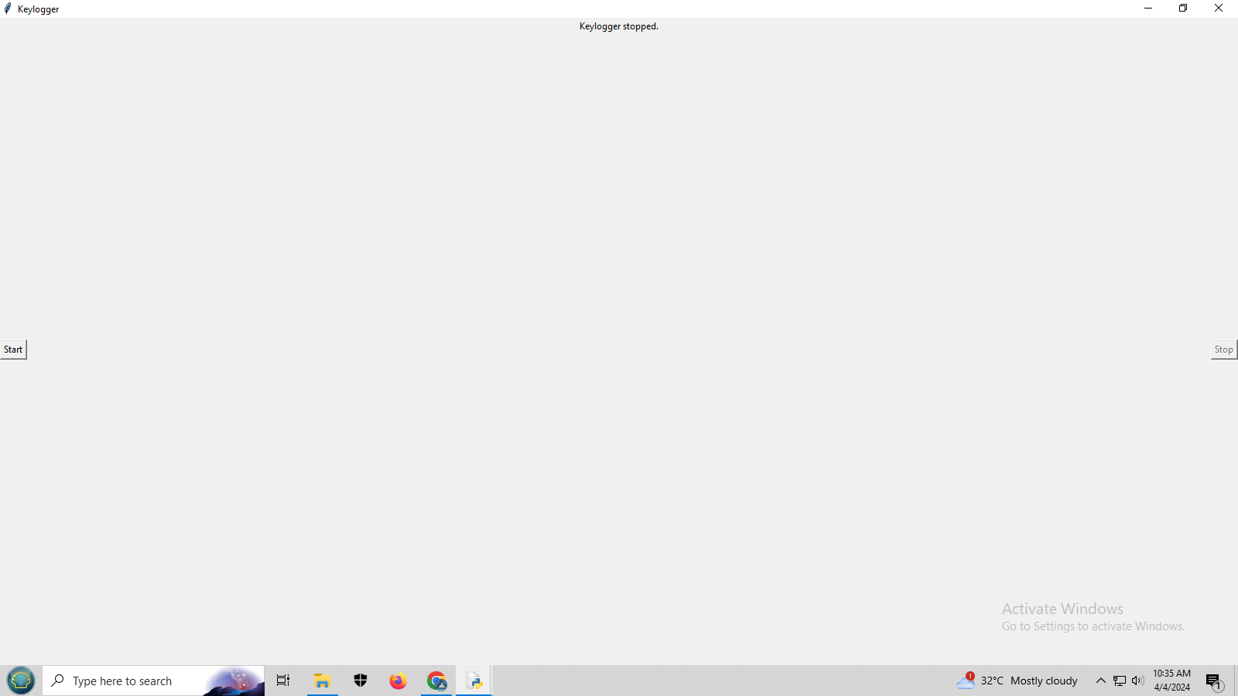
OUTPUTS

Slide 9
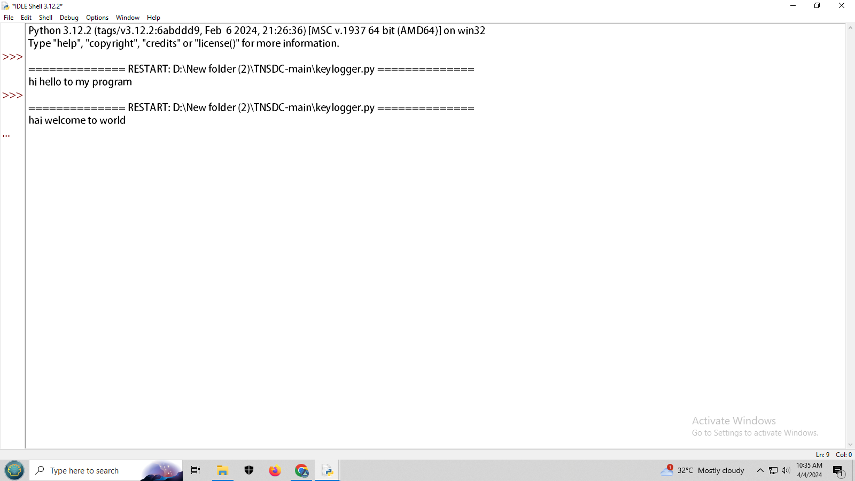

Slide 10


Slide 11
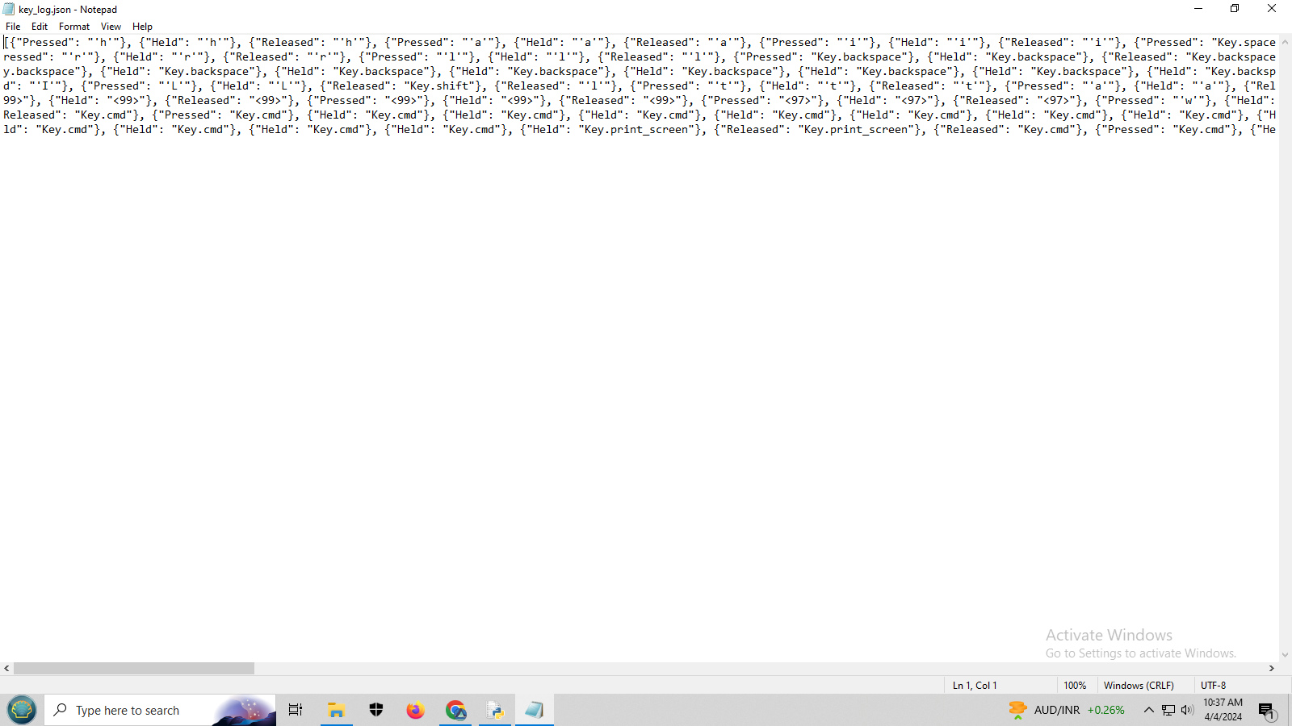

Slide 12
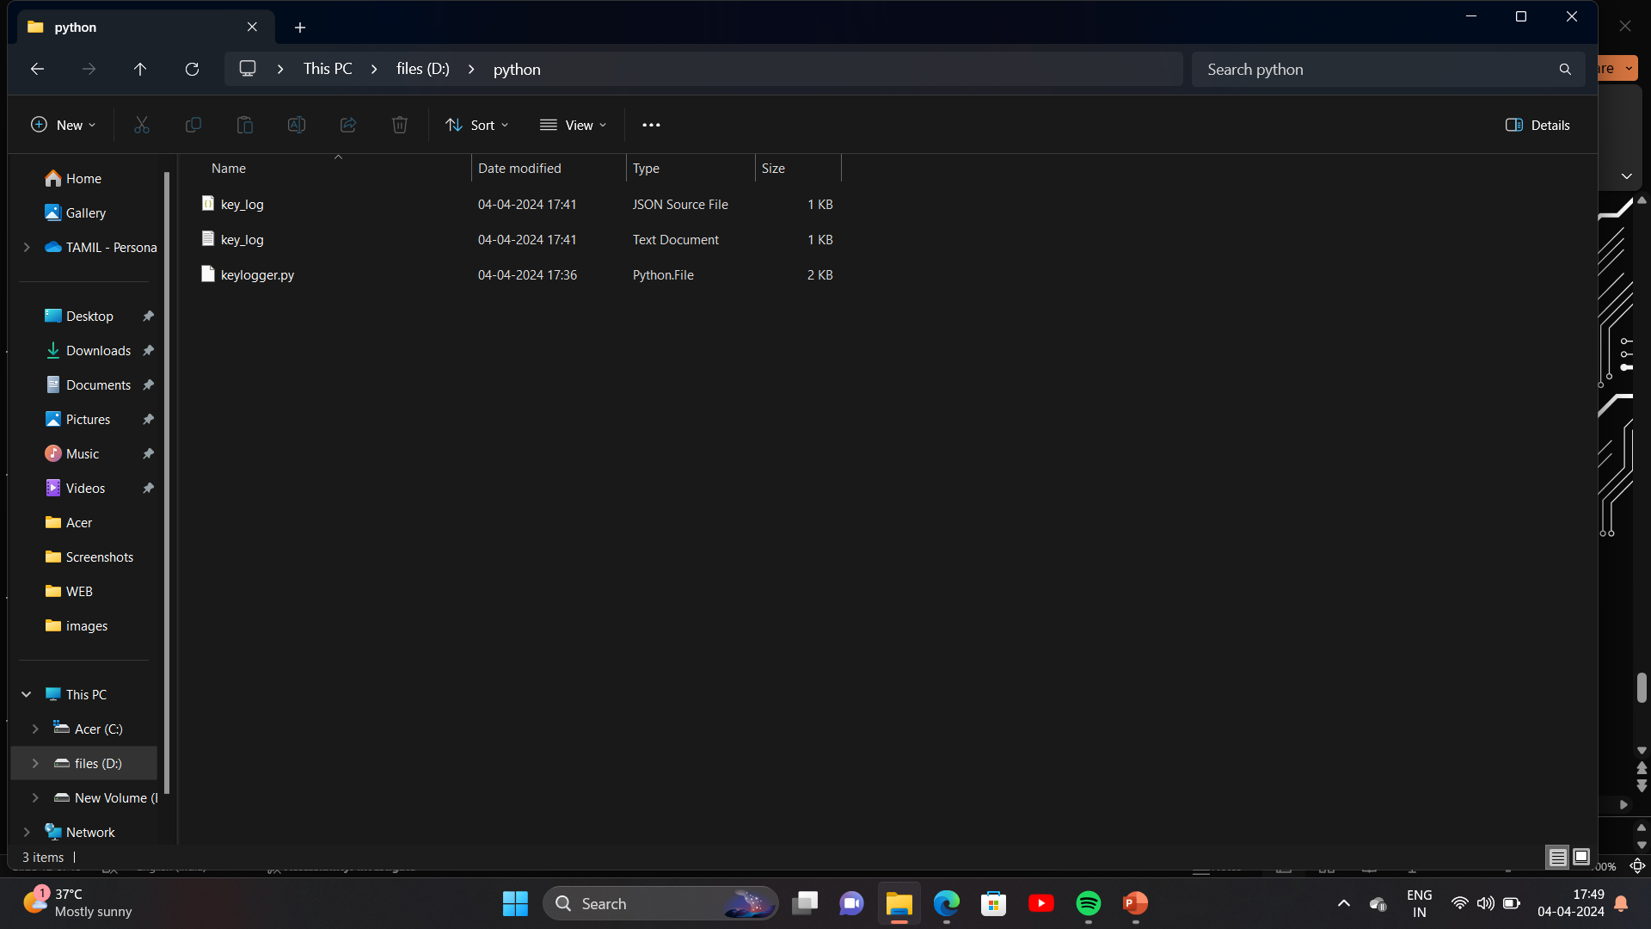

Slide 13
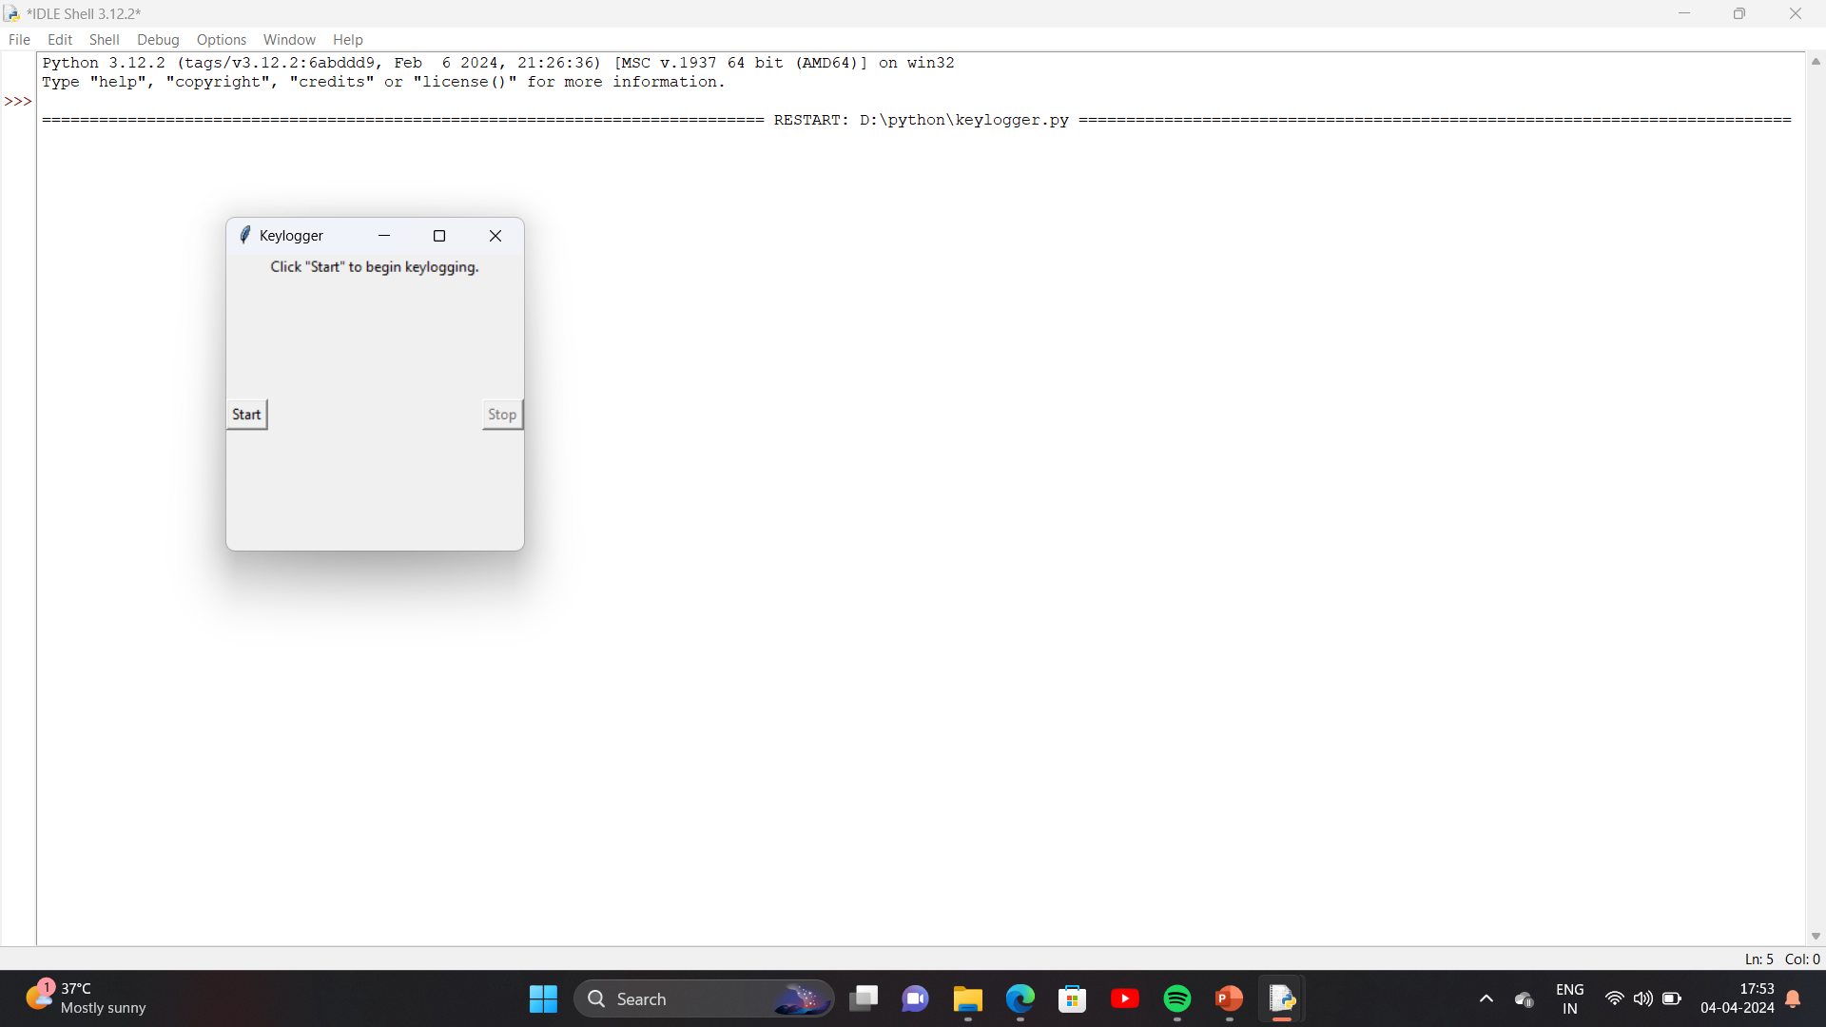

Slide 14
RESULT
Detection Accuracy:
Measure the accuracy of the detection algorithms in identifying keylogging activities. This can be quantified by metrics such as true positive rate, false positive rate, precision, and recall.
Prevention Efficacy:
Assess the effectiveness of the prevention and mitigation measures in stopping keylogging attacks before they escalate. This can be evaluated by tracking the number of successful prevention instances compared to attempted attacks.
System Performance:
The solution's impact on system performance, including CPU usage, memory consumption, and latency, should be measured to ensure lower resource usage and minimal system responsiveness.
user Satisfaction:
Gather feedback from end users regarding their satisfaction with the solution's usability, functionality, and effectiveness. Use surveys, interviews, or usability tests to quantify user satisfaction metrics.

Slide 15
CONCLUSION
The keyloggers—a type of software that records keystrokes on a computer. Our journey involved understanding the underlying concepts, implementing code, and considering ethical implications. That this keylogger was created solely for educational purposes. It should never be used maliciously or invade someone’s privacy. By building this keylogger, we gained insights into Python programming, file handling, and system-level interactions. Understanding how keyloggers work enhances our overall knowledge. Always prioritize privacy and ethical considerations. Respect boundaries and use this knowledge responsibly. If you plan to use this keylogger for personal learning, ensure it remains secure and remove any sensitive information (such as your own keystrokes) from the logs.Knowledge is powerful, but its application defines its impact. Use your skills wisely and ethically.

Slide 16
Thank you
=

